Slide 1
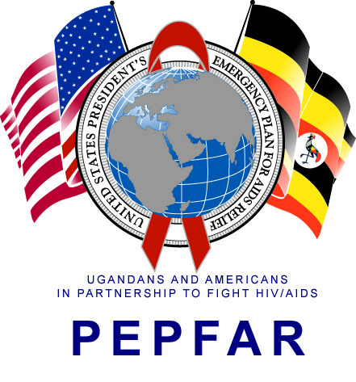
Improvement in timely infant HIV testing following monitoring of estimated date of delivery (EDD) and quality reporting for the urban districts of Kampala and Wakiso, Uganda
Zikulah Namukwaya¹, Rhoda Mwondha¹, Allan Simwogerere¹, Herbert Wasswa¹, Lilian Nakamatte¹, Doreen Maala¹, Catherine Ninsiima¹, Grace. M. Naikazi², Nelson Kalema¹, Joanita Kigozi¹, Alex Muganzi¹, Martin Ssuuna¹
¹Infectious Diseases Institute, Makerere College of Health Sciences, Makerere University, Kampala, Uganda. ²Mildmay Uganda
PEB0332
Background
Timely DNA PCR testing for HIV exposed infants is key to determining the care package for the infants and is associated with better health outcomes. Despite overall improvement in infant HIV testing, early infant diagnosis (EID) within 2 months of birth has remained low at 52% in sub-Saharan Africa, and only at 45% in Uganda by the end of 2018. We introduced maternal EDD tracking and supported quality reporting to improve timing of 1st PCR. We reviewed trends in EID testing rates from Jan 2015 to September 2019 to assess impact of improved EDD tracking and quality EID reporting.
Methods:
From April 2015, the Infectious Diseases Institute (IDI) strengthened EID services at 112 sites in the urban Kampala-Wakiso region that included: staff training and mentoring, M&E tools distribution and utilization, reporting through the national grid, quarterly performance reviews, and targeted quality improvement projects.
From November 2017, IDI strengthened monitoring EDD using the EDD tracker, a longitudinal register that enrols pregnant women at ANC1 using their EDD and follows them up through delivery to the time of 1st DNA PCR. Clients were followed up with a phone call or home visit as guided by the EDD. EID reports were submitted monthly to the district health information software (DHIS2) platform.
We extracted aggregate data for 0-2 month and calculated proportions against total 1st DNA PCR testing and computed trend analysis for proportions using STATA13
Results
Between Apr 2015 and Sep 2019, there was significant improvement in the proportion of infants testing within 2-months of age, from 30.1% in 2015 to 81.4% by Sept 2019 (pr>chi2 = 0.001)
Conclusion
Routine monitoring of EDD, timely program performance reviews and site-specific quality improvement interventions should be scaled up to all sites for improved timely EID testing and infant outcomes.
Acknowledgements
This program has been supported by the President’s Emergency Plan for AIDS Relief (PEPFAR) through CDC, Uganda under the terms of CoAg Number: GH002022.
PRESENTED AT THE 23RD INTERNATIONAL AIDS CONFERENCE (AIDS 2020) | 6-10 JULY 2020

